Slide 1
Entrepreneur Workshop
Recordkeeping & Taxes
October 8, 2018
Kimberly Hughes-Gill, CEO/President

Slide 2
Internal Revenue Service (IRS)
What New Business Owners Need to Know
  Business versus Hobby
  Selecting a Business Structure
  Sole Proprietor, Corporation, S Corporation, Partnership, LLC
  Employer Identification Number
  Form SS-4
  When Do I Start My Tax Year?
  Fiscal vs Calendar
Helpful Resources:
  www.irs.gov/businesses
  www.irs.gov

Slide 3
Missouri Department of Revenue
Starting a Business in Missouri – The Basics:
  Secretary of State Registering Business
  Charter & Articles of Incorporation
  Annual Reports
  Missouri Department of Revenue
  Employment Tax Identification Number & Filing Frequency
  Division of Employment Security
  Sales Tax
Helpful Resources:
  www.sos.mo.gov
  www.dor.mo.gov

Slide 4
City of St. Louis
License Collectors Office
  Business License
Collector of Revenue
  Earning Tax Department
  Forms P-10/W-10, E-234, E-6…etc.
  Helpful Resources:
    www.StLouisCollector.com
    www.StLouis-mo.gov/license-collector

Slide 5
Recordkeeping
  Recordkeeping
  Accounting System - QuickBooks, Excel Spreadsheet & Filing System
  Track Income, Expenses, Fixed Assets, Liabilities, Equity
  Accounting Software, Excel Spreadsheet, Filing System
  Financial Statements & Budgets
  Balance Sheet, Profit & Loss, Cash Flow Statement
  Business Taxes
  Income, Estimated Taxes, Employment Taxes
Thank You!

Slide 6
Chart of Accounts
Income
Grants, Sales, Donations
Expenses
Accounting, Office Supplies, Repairs
Fixed Assets
Vehicles, Buildings, Land
Liabilities
Loans
Equity
Assets – Liabilities = Equity

Slide 7
Financial Statements
Balance Sheet
Reflects a point in time
Assets + Liabilities = Equity
Income Statement
Profit & Loss for a period
Income - Expenses
Cash Flow Statement
Operations
Investments
Financing
Statement of Change
Reflects changes in Equity

Slide 8
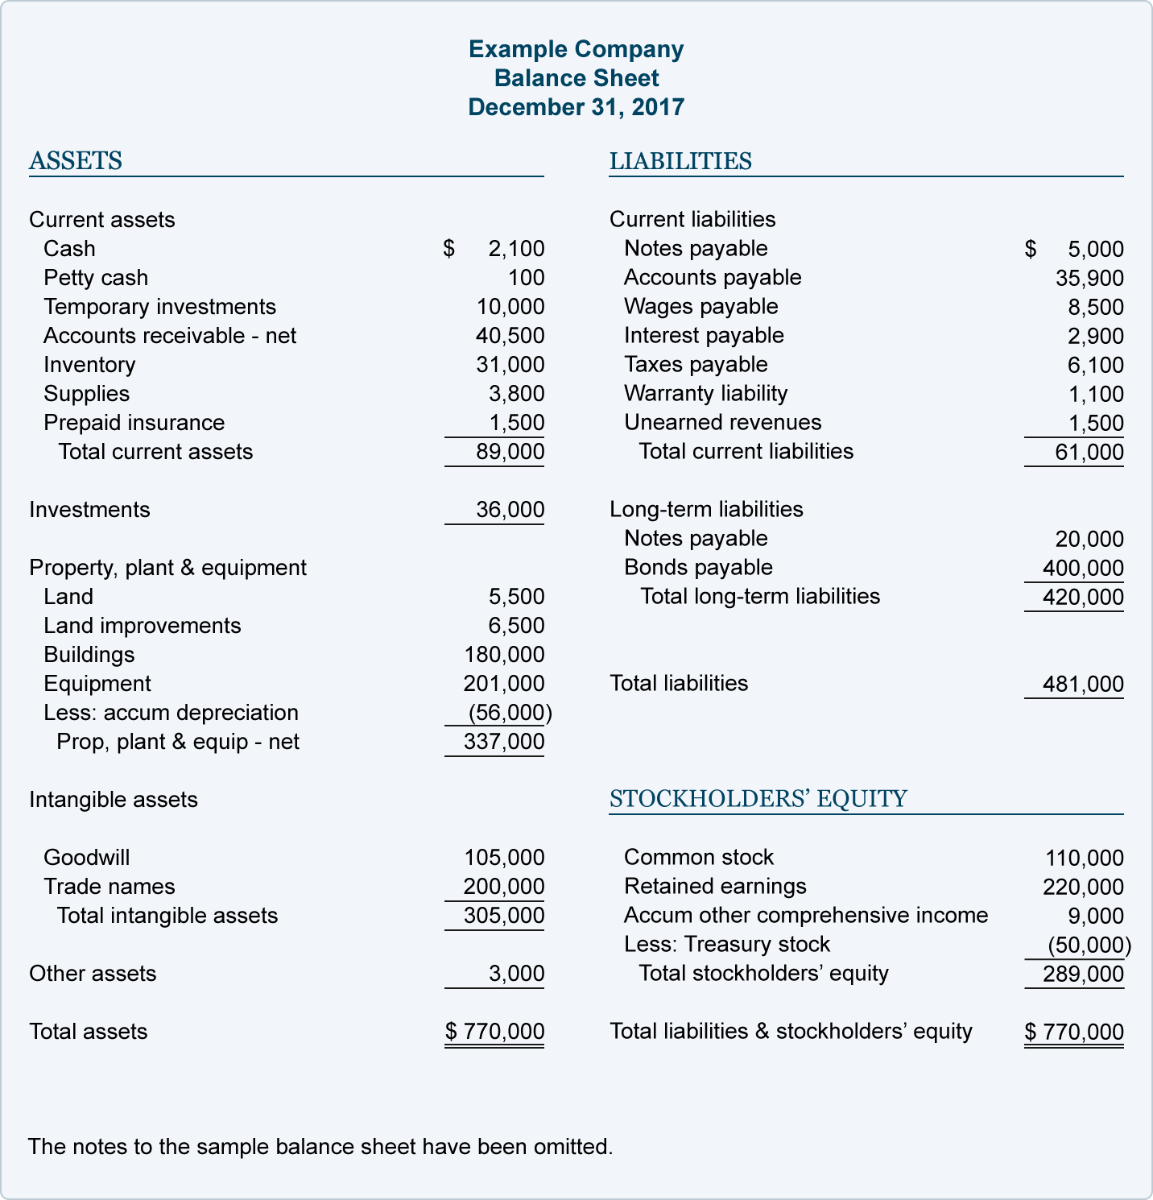
Example of Balance Sheet

Slide 9
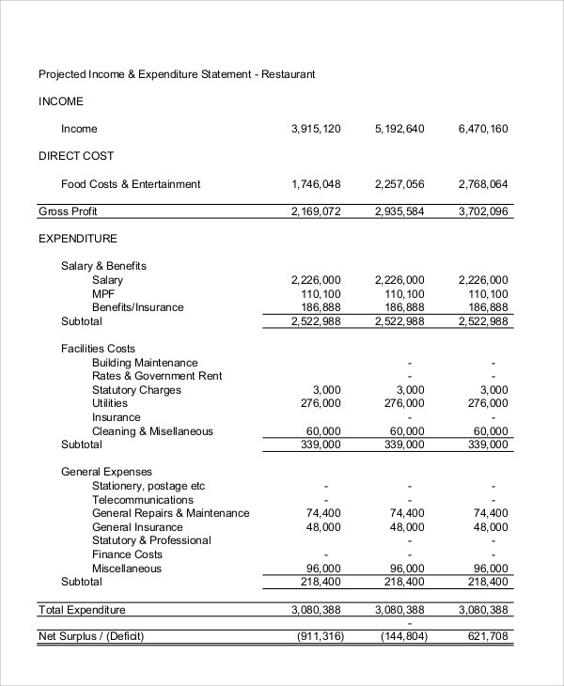
Profit and Loss (Income Statement)

Slide 10
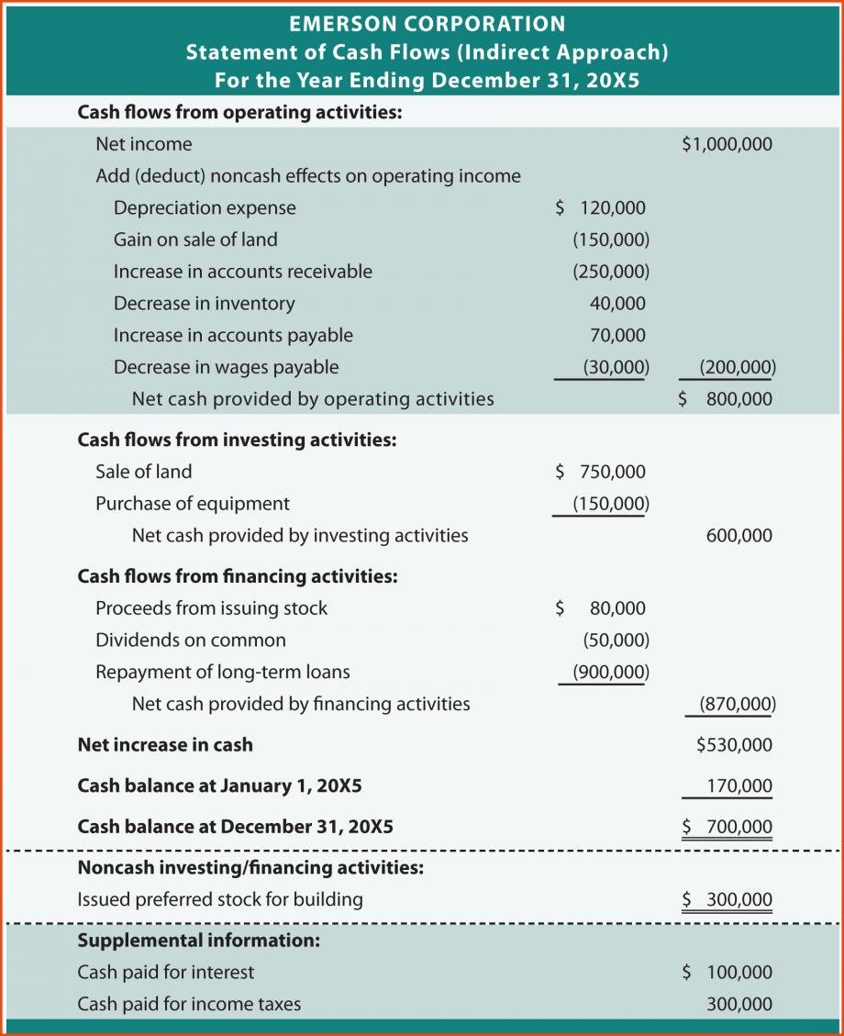
Example of Cash Flow Statement

Slide 11
Bookkeeper vs Accountant
Bookkeeper
Record daily transactions
in a organized consistent
manner
Enter & Pay Bills
Invoice & Record Payments
Payroll
Reconcile Accounts
Tax Payments
Accountant
Analyze & advise the impact of financial data
Tax Preparation
Audit

Slide 12
Show love to your Bookkeeper or Accountant
Stay organized
Keep records & receipts
Respond timely to request
Communicate
Discuss financial decisions

Slide 13
References
http://gotta.yotti.co/restaurant-income-statement-example/
https://www.accountingcoach.com/balance-sheet/explanation/4
https://www.askoverflow.com/indirect-cash-flow-statement-example/cash-flow-statement-example-emersonindirect-sponsorship-letter-why/

Slide 14
Contact us
314.740.1888 bkjassociates2@gmail.com
Any questions?
THANK YOU!

